Slide 1
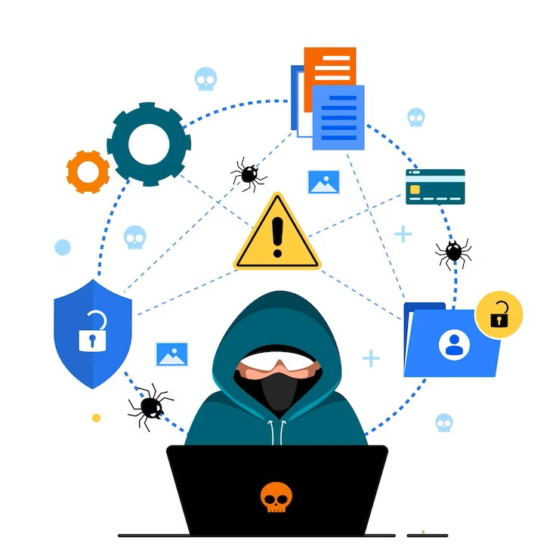
Cyber Discovery Toolkit: Ethical Hacking, Remote Control, and Phishing Awareness
Team Member:
- Md Hatif Farooque (1AM21CS111)
Guide: Ms. Pallavi

Slide 2
Abstract
Explore the "Cyber Discovery Toolkit: Ethical Hacking, Remote Control, and Phishing Awareness" project—a dynamic initiative designed to enhance cybersecurity awareness and knowledge. This educational endeavor aims to equip users with insights into security vulnerabilities, ethical hacking, and responsible online practices through interactive experiences.
Key highlights include:
Ethical Hacking Exploration:
Understand ethical hacking principles and learn how to identify and address vulnerabilities.
Gain insights into proactive security measures to protect digital assets.
Remote System Control Demonstration:
Experience a reverse shell mechanism that showcases controlled connections between systems.
Explore remote command execution and its implications within a secure environment.
Phishing Awareness and Best Practices:
Learn to recognize phishing attacks and safeguard against fraudulent activities.
Embrace cyber hygiene practices for enhanced online safety.
Interactive Simulations:
Engage with interactive scenarios that mirror real-world cybersecurity challenges.
Make informed decisions and navigate ethical dilemmas.

Slide 3
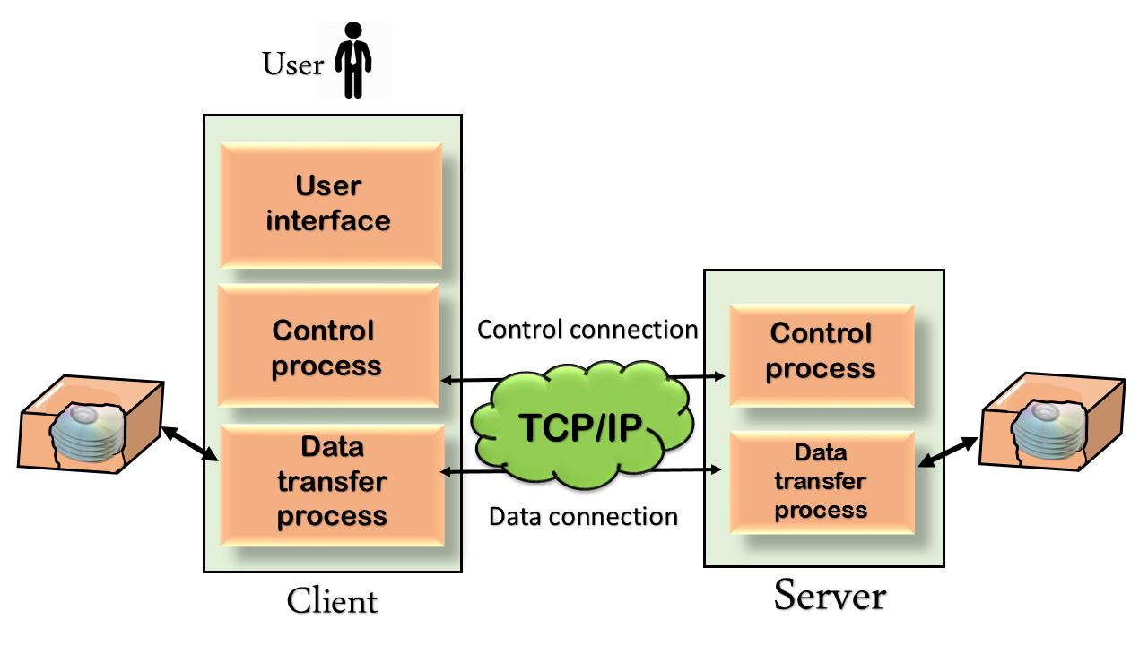
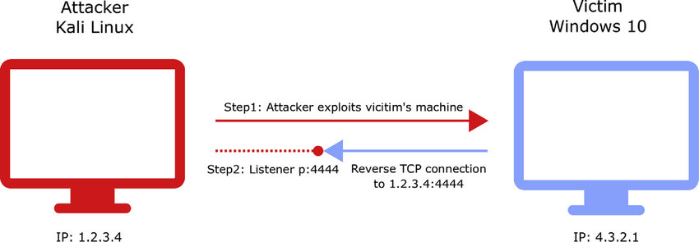
Architectural Diagram and Key Concepts
Image 1: Reverse Shell
"Image 1 demonstrates the concept of a reverse shell, where the target system establishes a controlled connection back to the server. This allows remote command execution and interaction, illustrating the core functionality of the project."
Image 2: File Transfer Protocol
"Image 2 showcases the concept of a file transfer protocol, enabling secure and efficient exchange of data between systems. This illustrates the project's emphasis on responsible file sharing practices."

